Slide 1
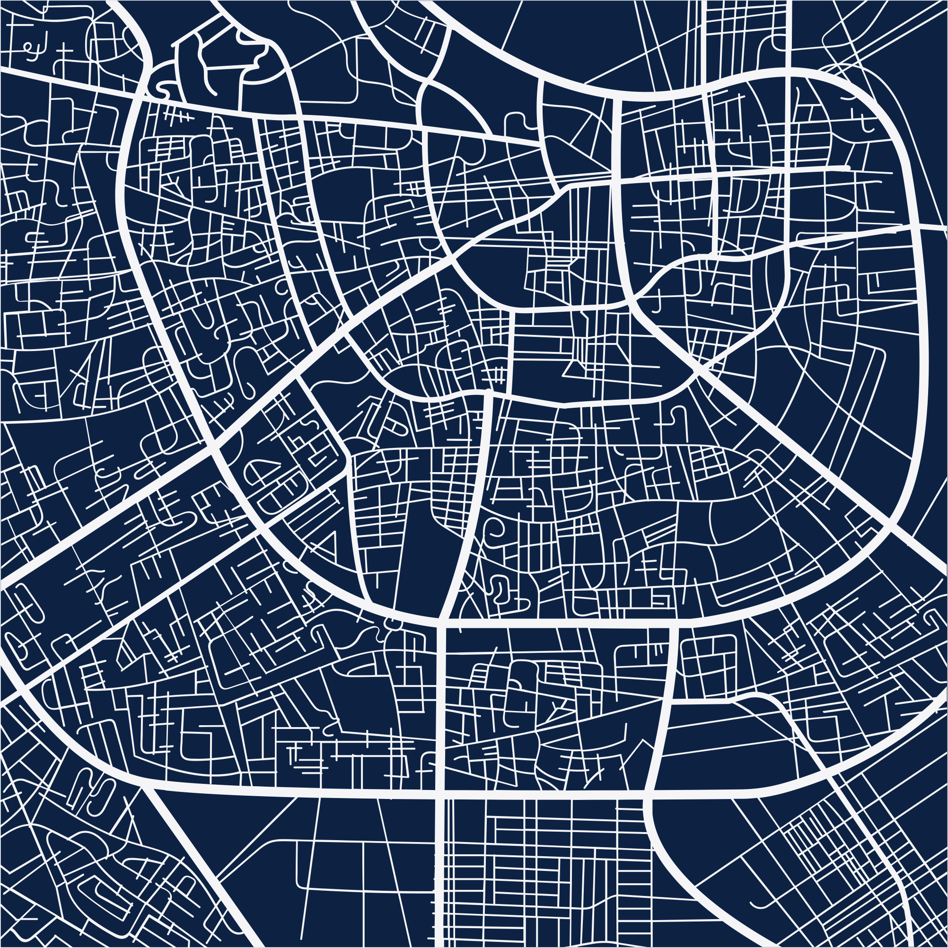


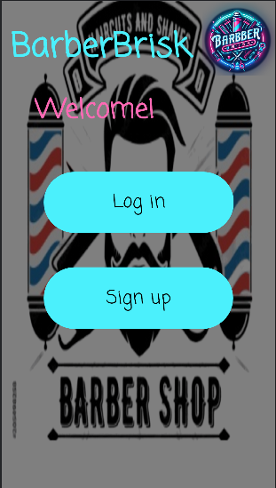
Get Haircut now!
BarberBrisk!

Slide 2
Our Partners
Elon Ezra
Avi Rahimov
Asaf Yekutiel
Dor Harizi
Team leader
Team member
Team member
Team member
Ratting system
DB design
Notification system
Haircut type system
Implementing profile page of barber and client
Login page
Overall design of the app except for the barber
Writing the DB interface
Implementing a significant part of the client/barber functionality
Implementing the DB functions
Creating some of the objects
Creating the sign-up page
appointment system
Designing the barber
Implementing the parcel object
Creating additional objects
Payment system

Slide 3
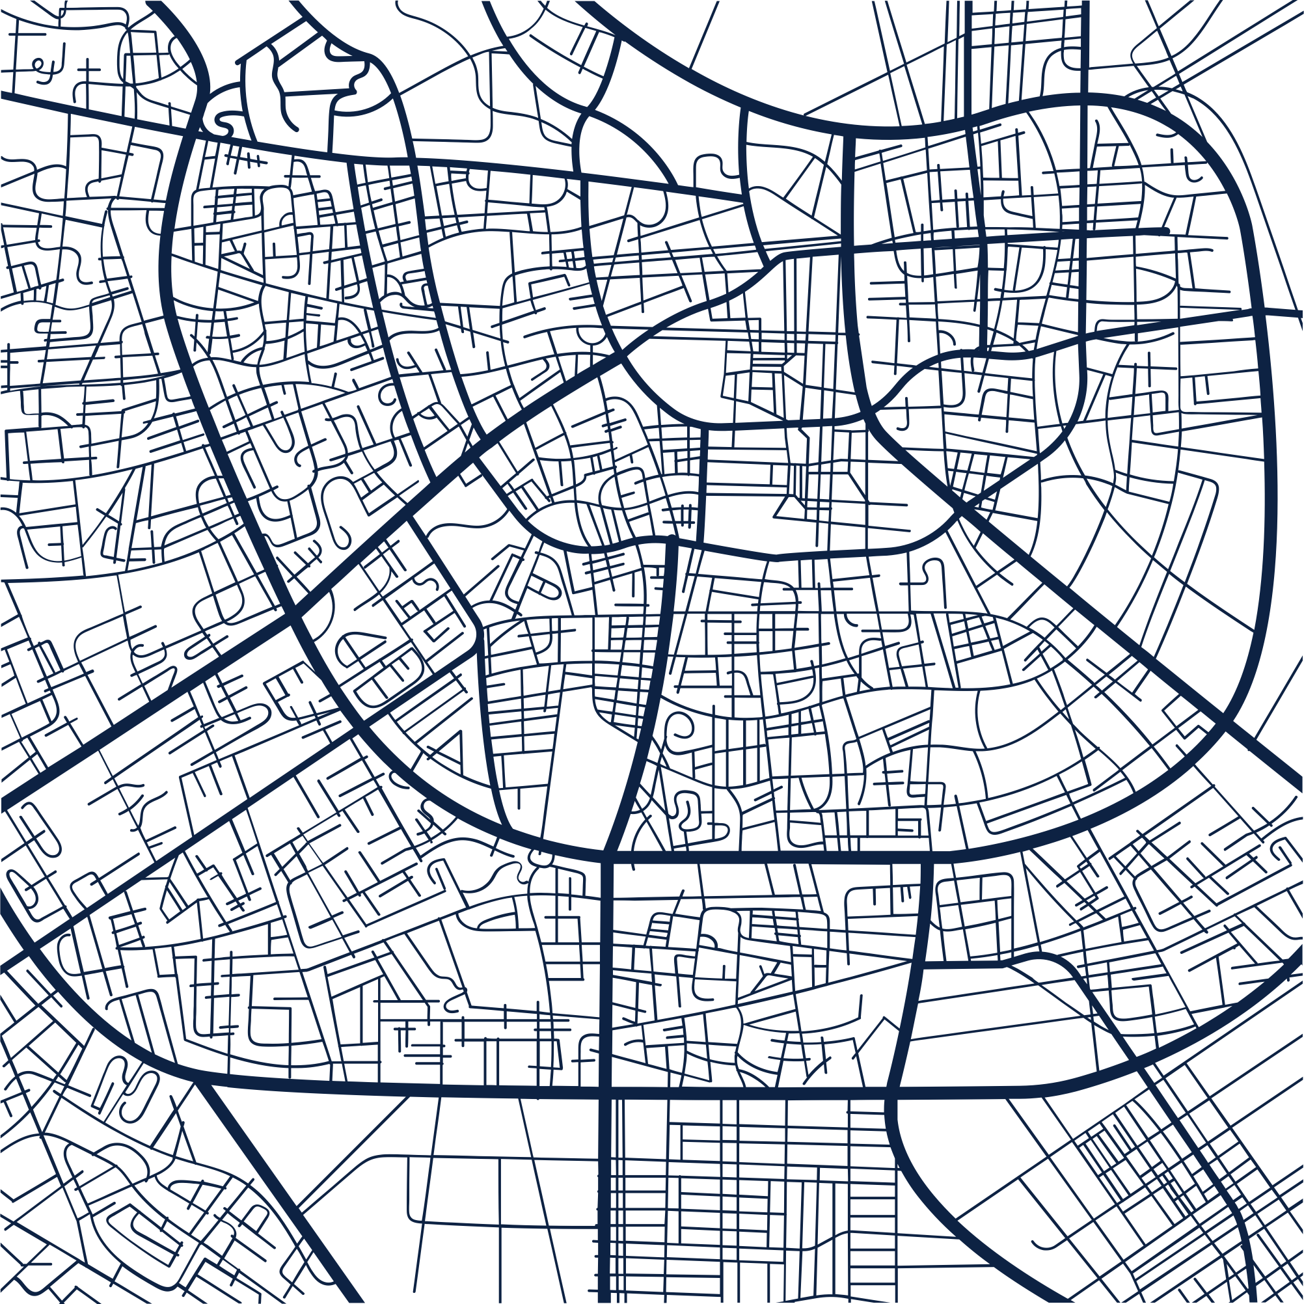
Reasons for setting up the app
•
Enhance User Accessibility
Improve Decision Making
Increase Barber Visibility
User-friendly interface for scheduling appointments with barbers.
Easy selection of services, appointment times, and barber choices
Simplified process for booking appointments.
Incorporation of a rating system
Assistance in making informed decisions in barber choosing
Utilization of others experiences
Platform for barbers to showcase services
Receive customer feedback.
Improve visibility to potential clients.
Notes:
הסיבות להקמת האפליקציה

Slide 4

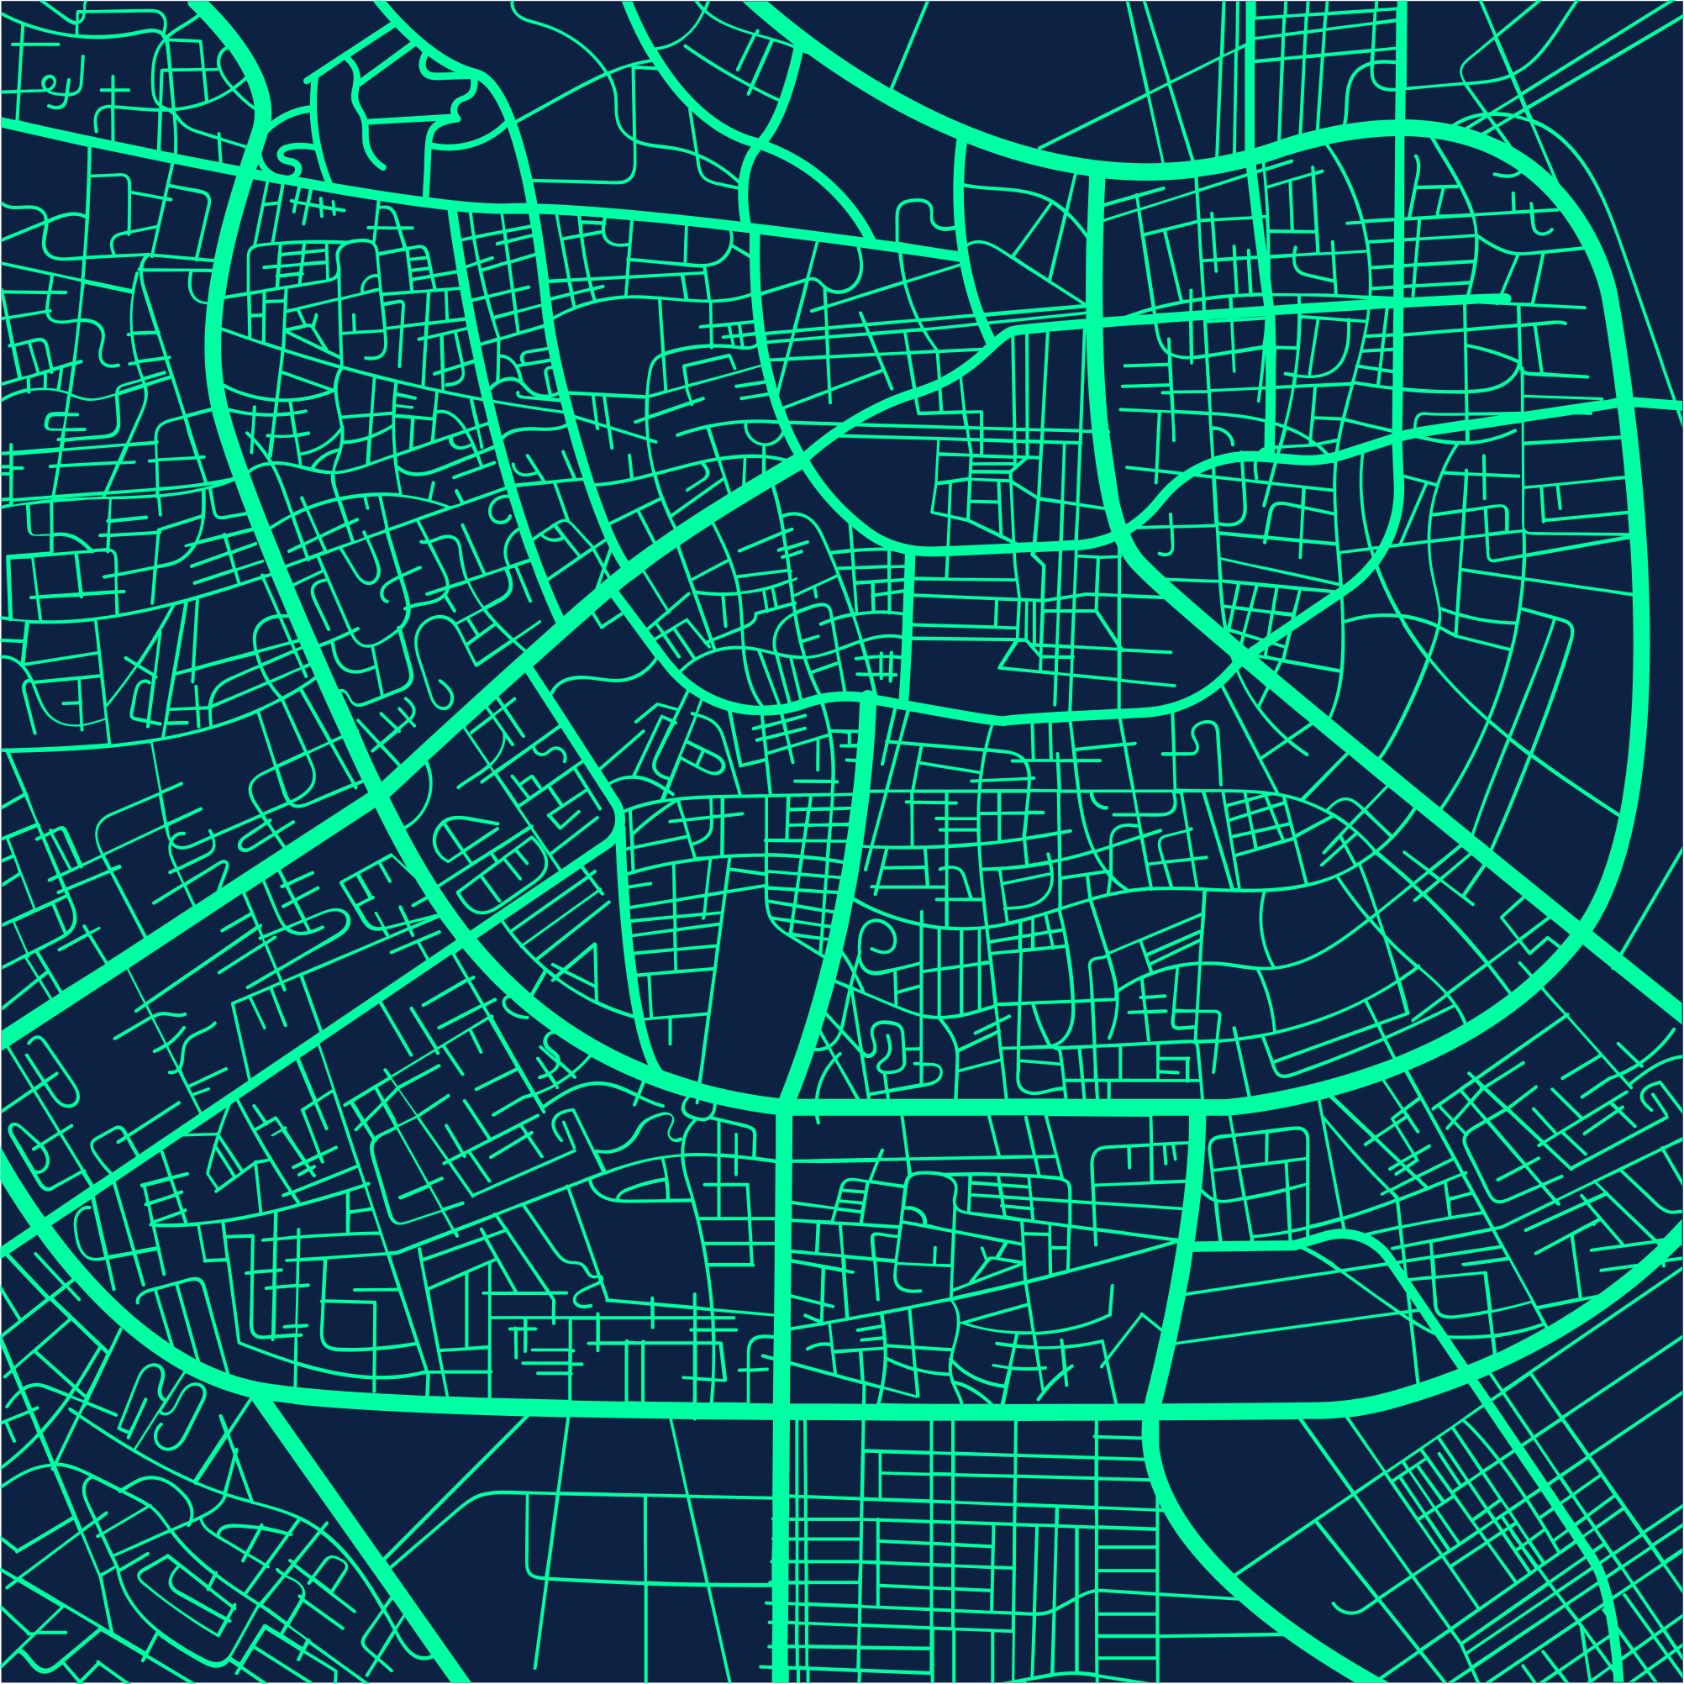
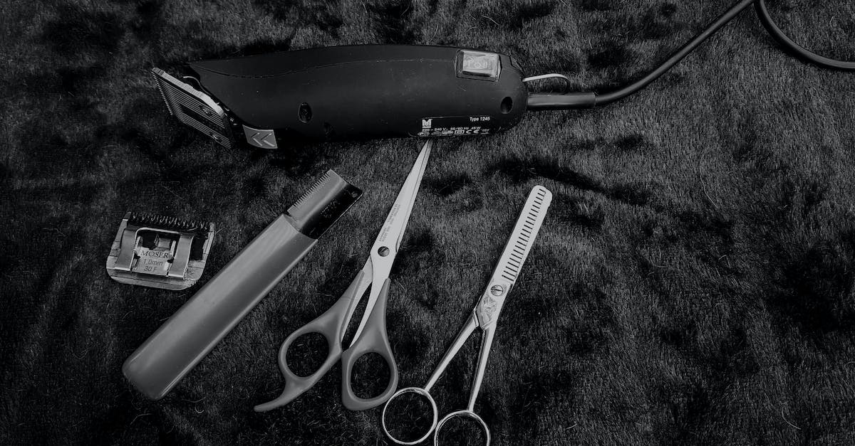
Requirements

Slide 5
Requirements
Functional requirements
Client Functionality:
Barber Functionality:
Appointment order (including Barber choosing. Haircut style and date
Profile view
Payment system
Displaying all appointments
Rating barber
Edit profile
Log-in
Sign-up
Set Appointment
Profile view
Set Hairstyle
Edit profile
Log-in
Sign-up

Slide 6
Requirements
Non-Functional requirements
Availability: The app is available 24/7
Compatibility: The app is compatible with a wide range of android devices
Usability: The app have an intuitive interface that is easy to navigate
Scalability: The app can handle many users simultaneously without degradation in performance
Security: All user data stored by the app encrypted

Slide 7

Central Features
Log-in
Log as client or barber via Email address
Signup
New users can choose to have barber or client account according their role
Appointment system
Barbers can inform users their job time and clients can set an appointment to their favorite barber
Rating system
After appointment users can give feedback how was the service

Slide 8
UML Diagrams

Slide 9
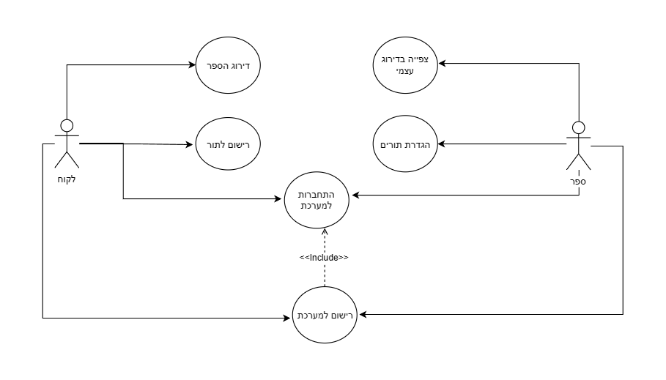
Use case diagram
Description
Relationship between each classes in the project

Slide 10
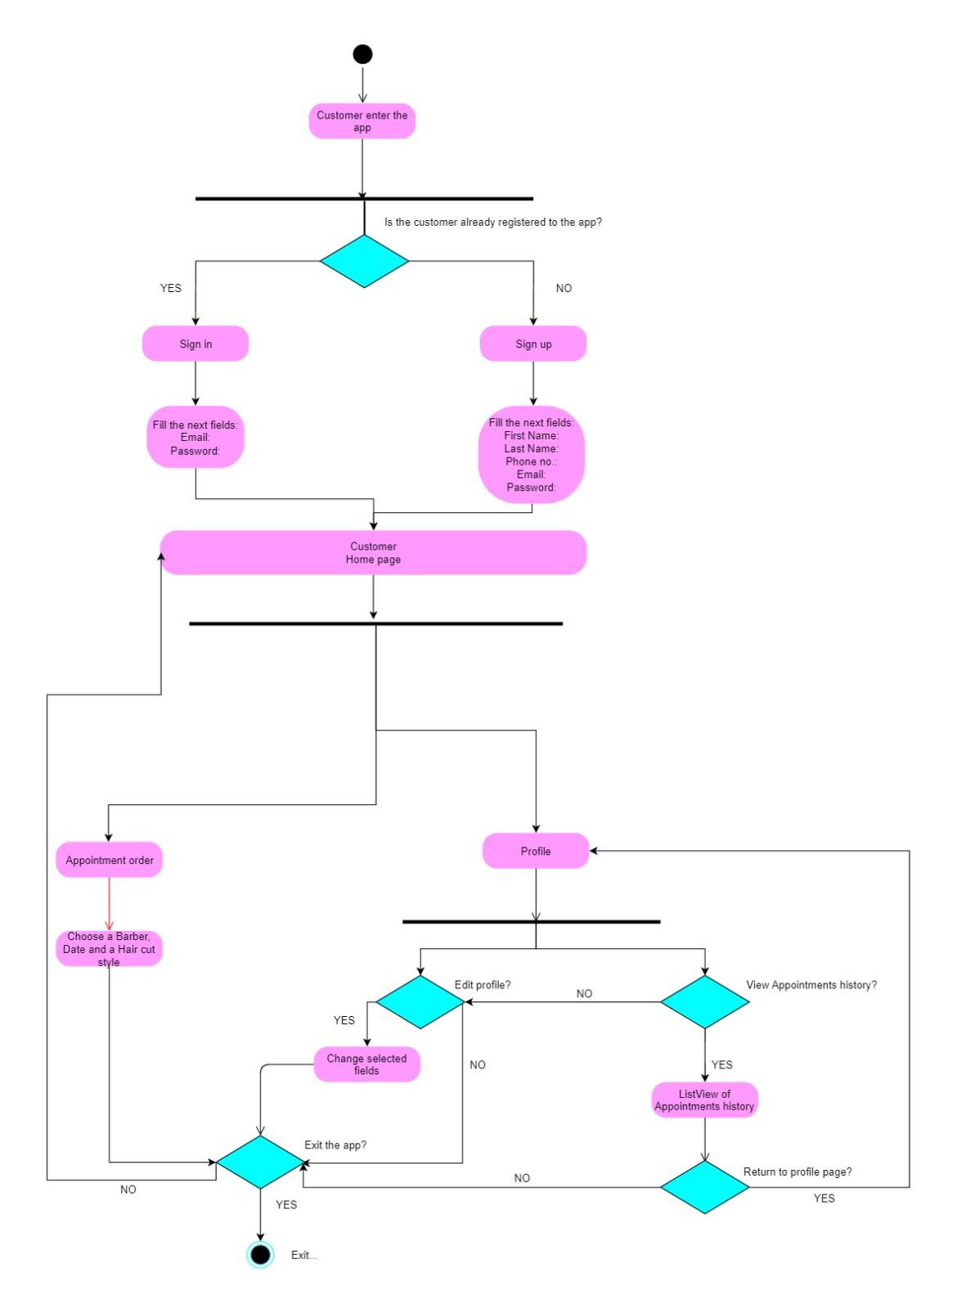
Activity diagram
Description
Flow chart of the main features of the app.

Slide 11
Description
Flow chart of the main features of the app.

Slide 12
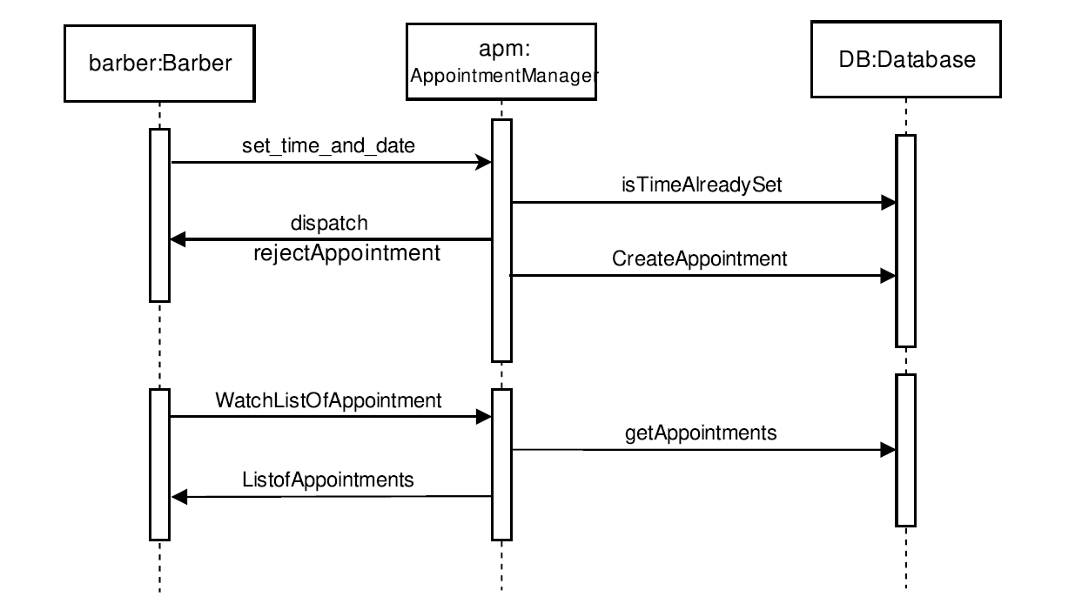
Sequence diagram
Description
Demonstration of setting appointment by the barber

Slide 13
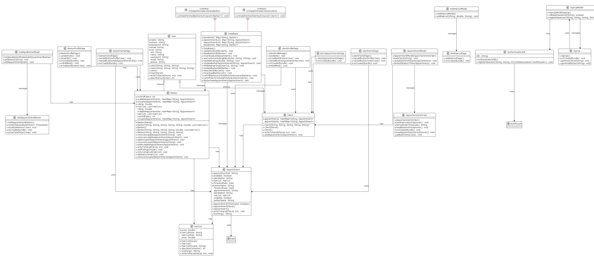
Class diagram
Description
Relationship between each classes in the project

Slide 14
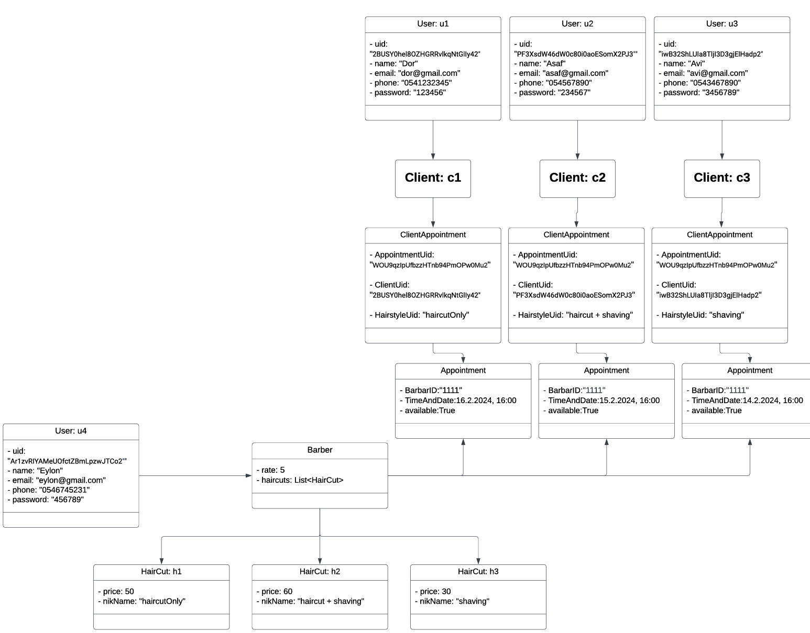
Object diagram
Description
Demonstration of objects flow with examples

Slide 15
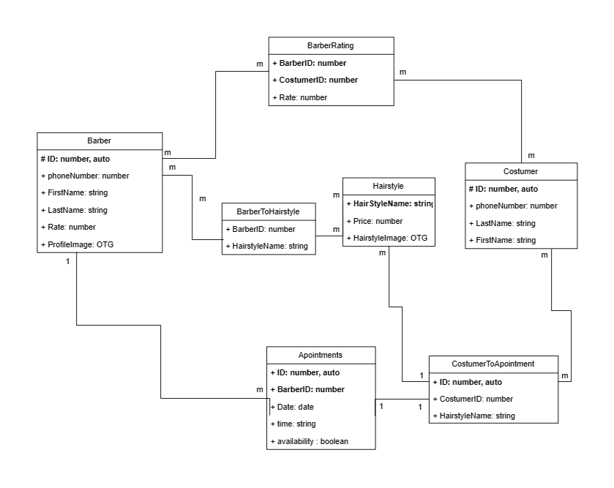
ERD diagram
Description
Demonstration Planning of the DB interface

Slide 16
App demonstration

Slide 17
•
open screen
•

Slide 18
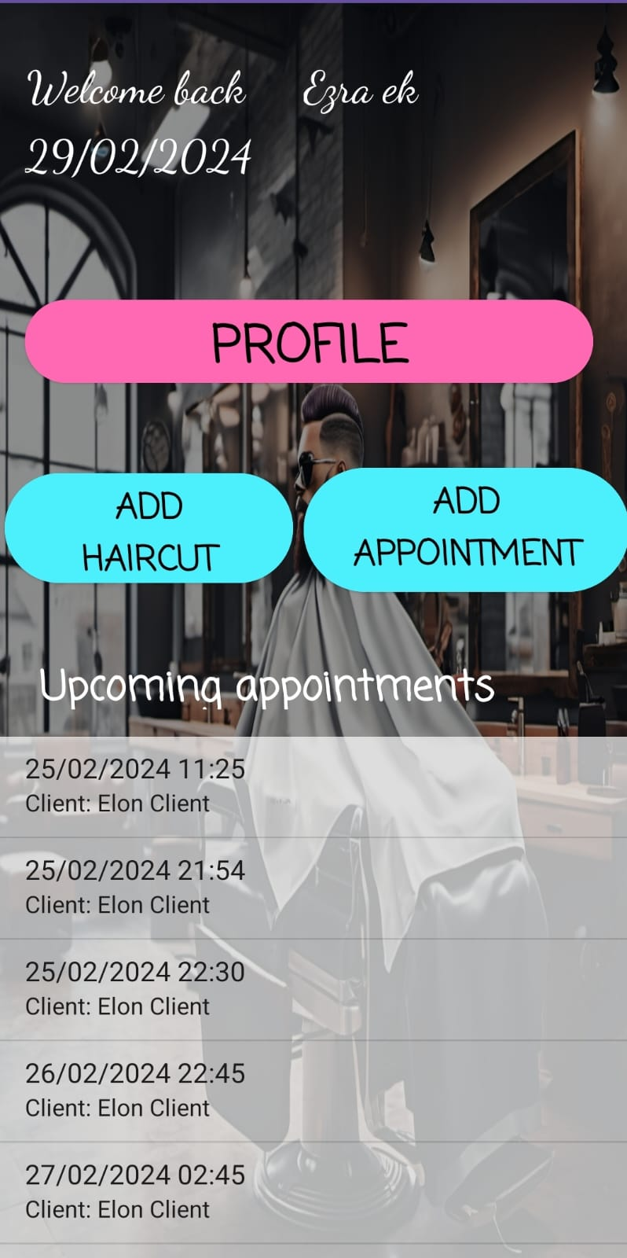
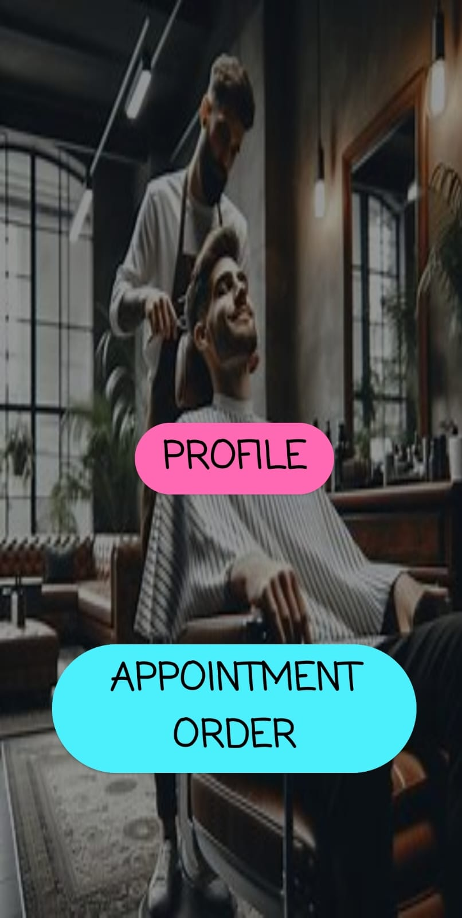
•
•
Barber home page
Client home page

Slide 19
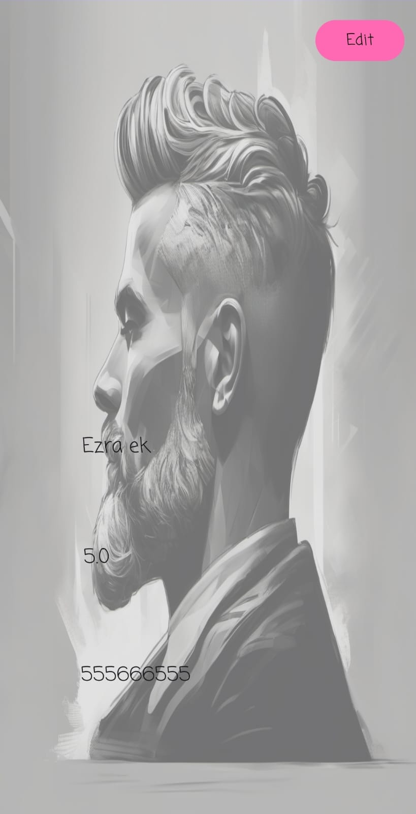
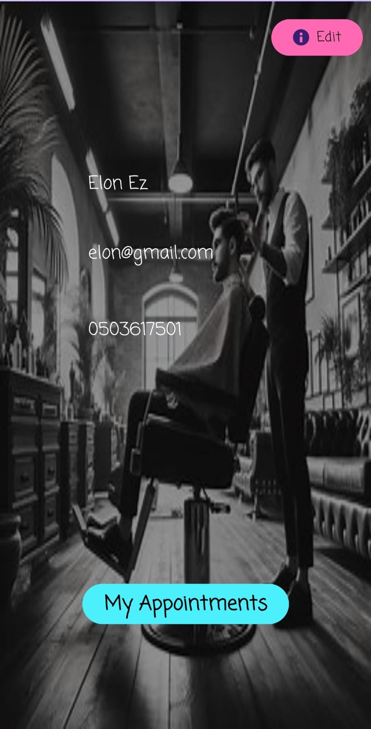
•
•
Barber profile page
Client profile page

Slide 20
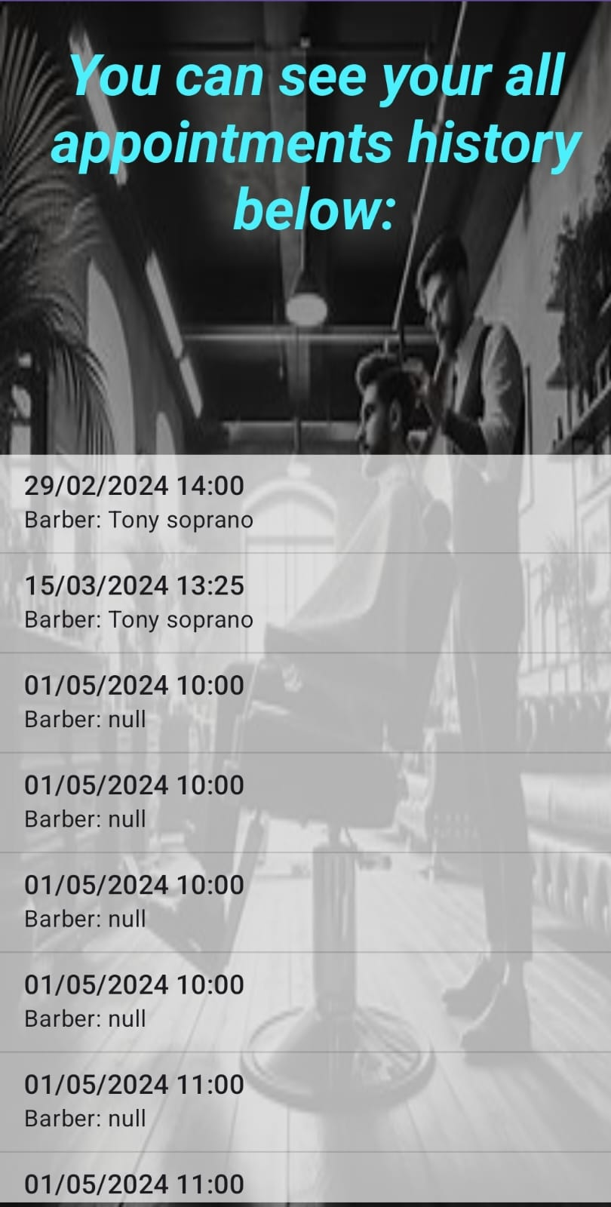
•
Client profile page
Client can watch his appointments

Slide 21
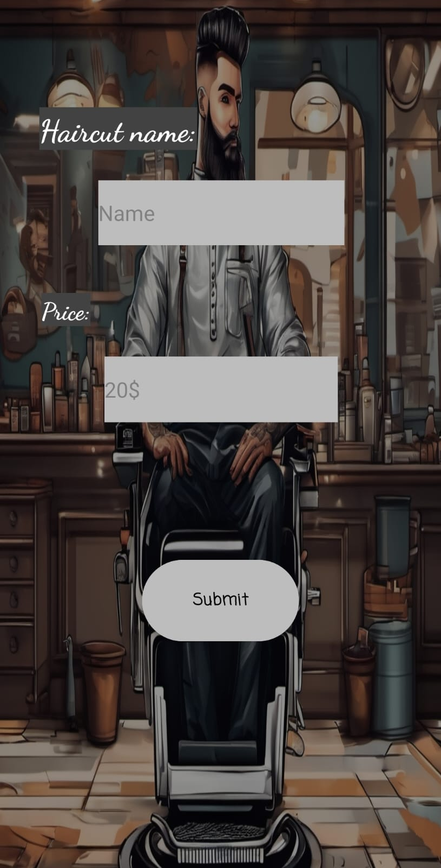
•
Add haircut
Barber can add the haircut he knows
•

Slide 22
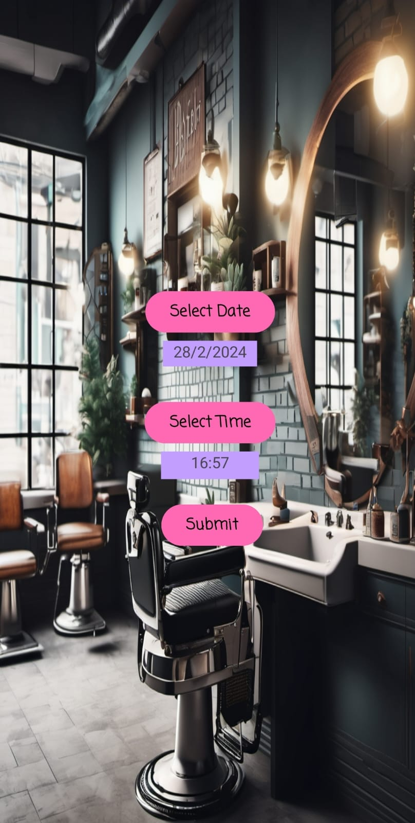
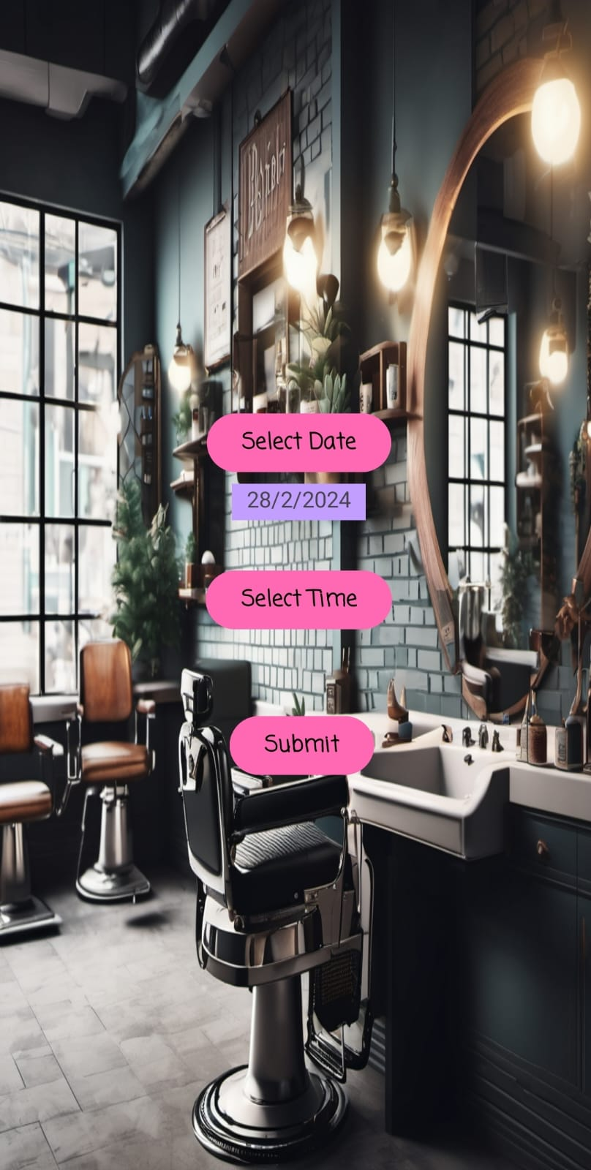
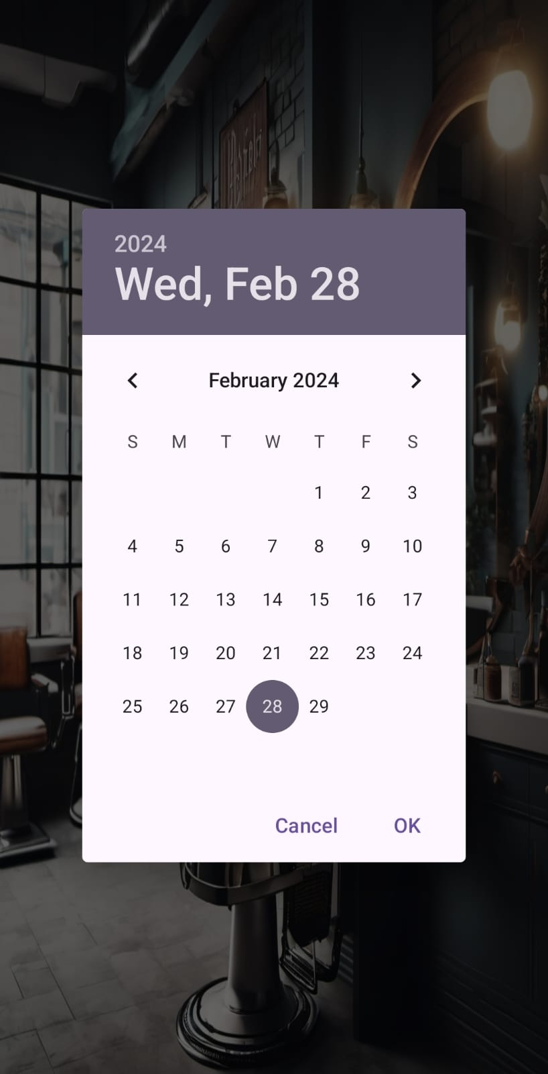
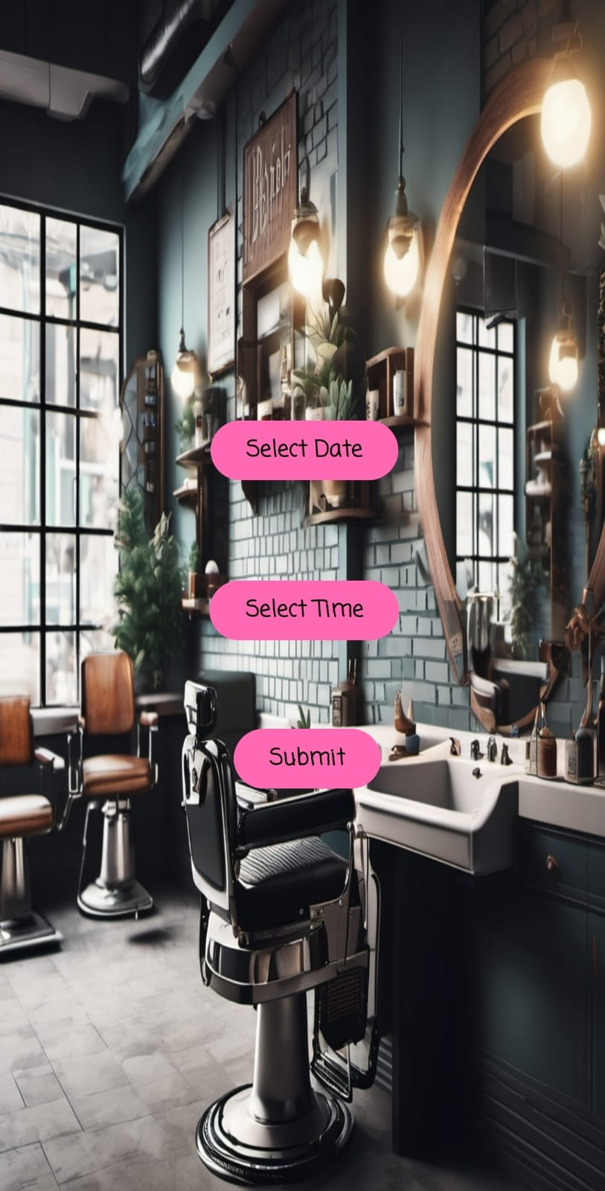
Set appointment by barber

Slide 23
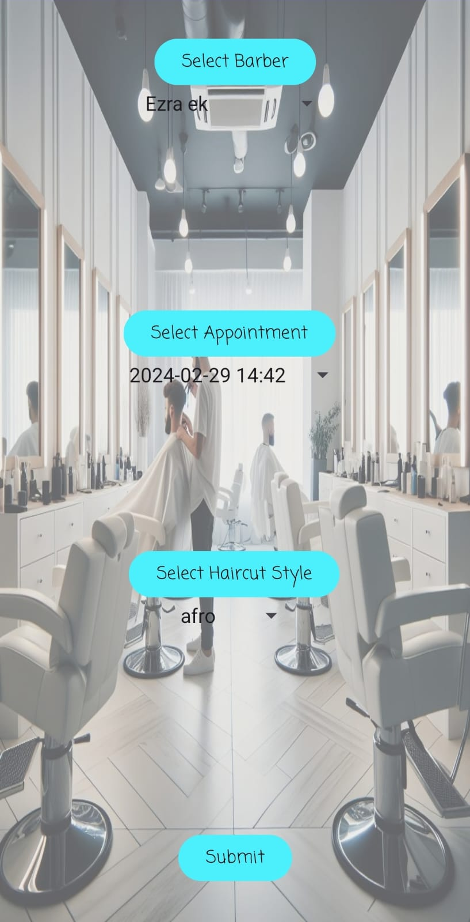
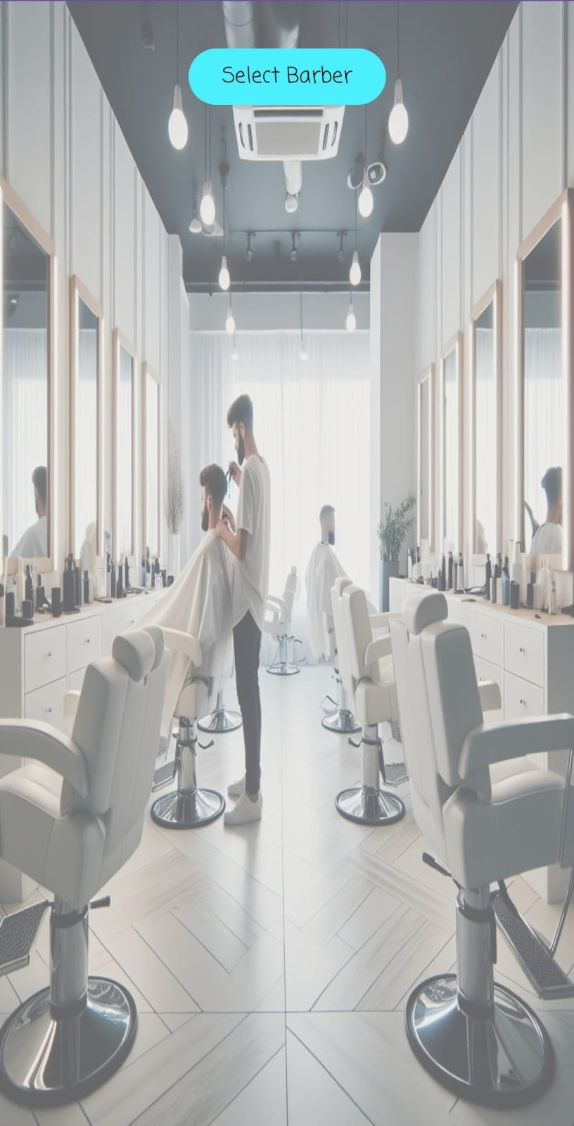
Set appointment by client

Slide 24
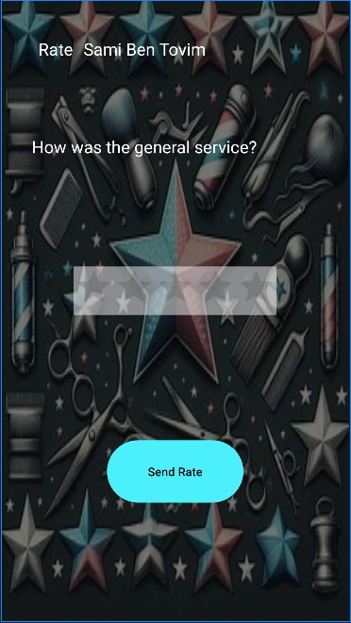
•
Rate your barber
client can rate their barber after the appointment
•

Slide 25
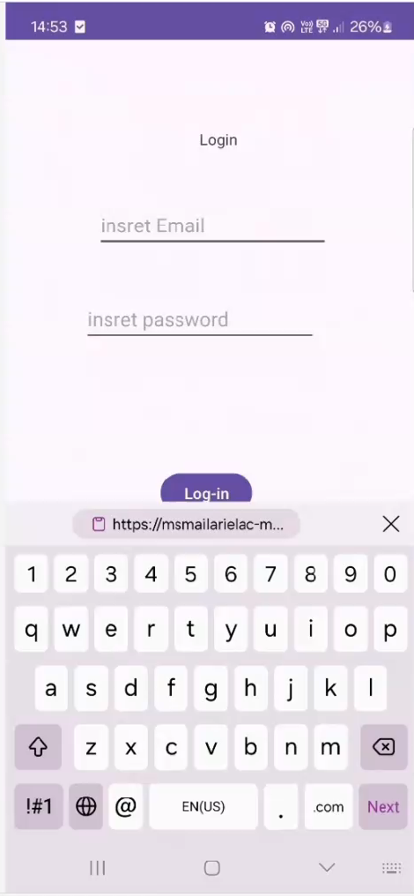
Set an appointment and rating - video example 📽

Slide 26
Technology usage
IDE
Android studio
Database
firebase,
Firestore – for entities
Firebase Authentication – user managment
Development language
Java

Slide 27
Development gaps
AI Chat
Client could have the ability to set appointment by chatting with an AI chat bot
Payment system
Client could have to pay in advance using payment system in order to order an appointment
Canceling appointments
If a user regrets, or cannot arrive, he can cancel the appointment about 4 hours before the start of the appointment.
Forget password
user may have the ability to recover his password if he forgot it.

Slide 28
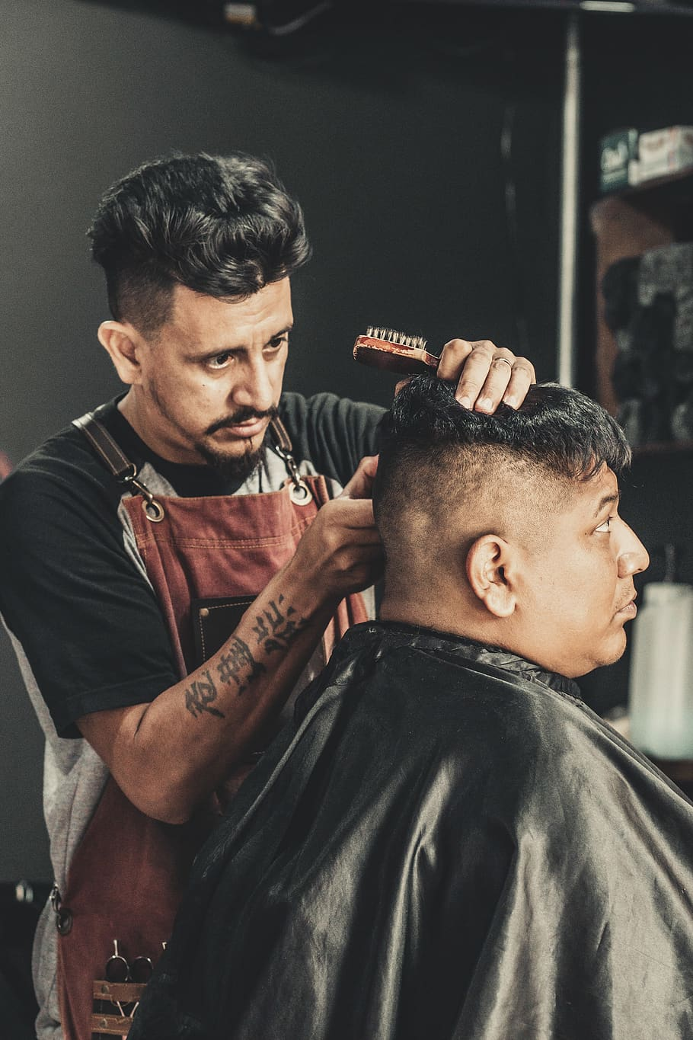



Thank you for listening!
https://github.com/BarberBrisk-team/BarberBrisk
@BarberBrisk
BarberBrisk.com

